Slide 1
Design Law 101
A toolkit for protecting and making money from your artwork while respecting others’ work.
April 24, 2019– Columbia College / Business of Design
Law Office of Lesley A. Wallerstein, LLC
500 Lake Cook Road, Suite 350
Deerfield IL 60015
(847) 912-3553
law@wallerstein-ip.com

Slide 2

Copyrights

Slide 3
What is a Copyright?
Federal statute gives “authors” the exclusive right to:
        Perform
        Display
        Distribute
        Reproduce
        Create “derivative works of”
Their work

Slide 4
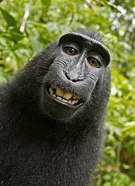
Who can own a copyright?
Naruto the macaque took this selfie but he is not a “person” therefore can’t copyright it

Slide 5
What does a copyright protect?
Paintings, sculpture, photographs
Books
Music
Drama
Movies

Slide 6
Why register a copyright?
Inexpensive - $35/$55 filing fee
Long term – Author’s life + 70 years
Right to sue in federal court
Collect damages if you win
  $750 - $30,000 per work, up to $150,000
  if copying is willful
And also recoup your attorneys’ fees

Slide 7
How to register a copyright
U.S. Copyright Office – www.copyright.gov

Slide 8
About the registration process:
“Examined” for originality/lack of utility
Process is difficult to track / opaque
9+ months to receive certificate
Appeal rejections - $200+

Slide 9
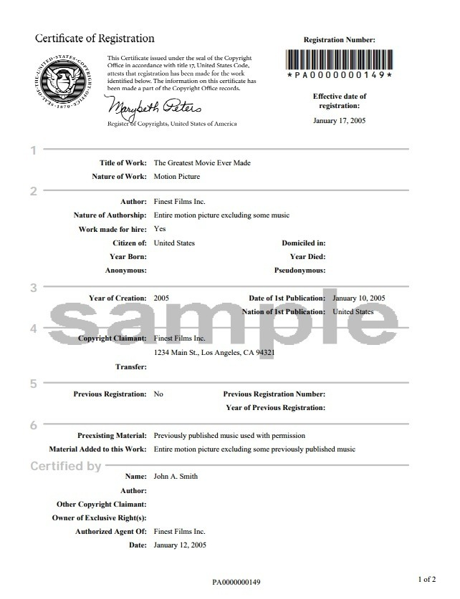

Slide 10
Copyright Infringement
What is infringement and what is not?
  Copying without permission
  Intent or knowledge not needed
“Fair Use” defense – depends on purpose and effect of copying
  Social commentary / First Amendment
  Educational
  Minimal borrowing
  Financial impact on copyright owner

Slide 11
When do you need permission (a “license”)
to use a photo? When you do not?
      Rule of thumb: if you did not take the photo, you need permission.
      Exceptions:
      Public Domain – works created before 1923
      Creative Commons license
      Other, written, permission

Slide 12
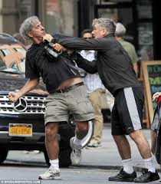
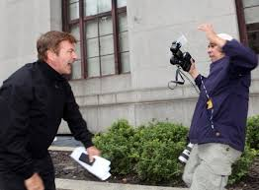
When do you need permission to *take* a photo of someone?
    Can you identify the person in the photo?
    Expectation of privacy: public / private space
    Celebrities and public figures
    When in doubt, ask permission (written is best!)

Slide 13
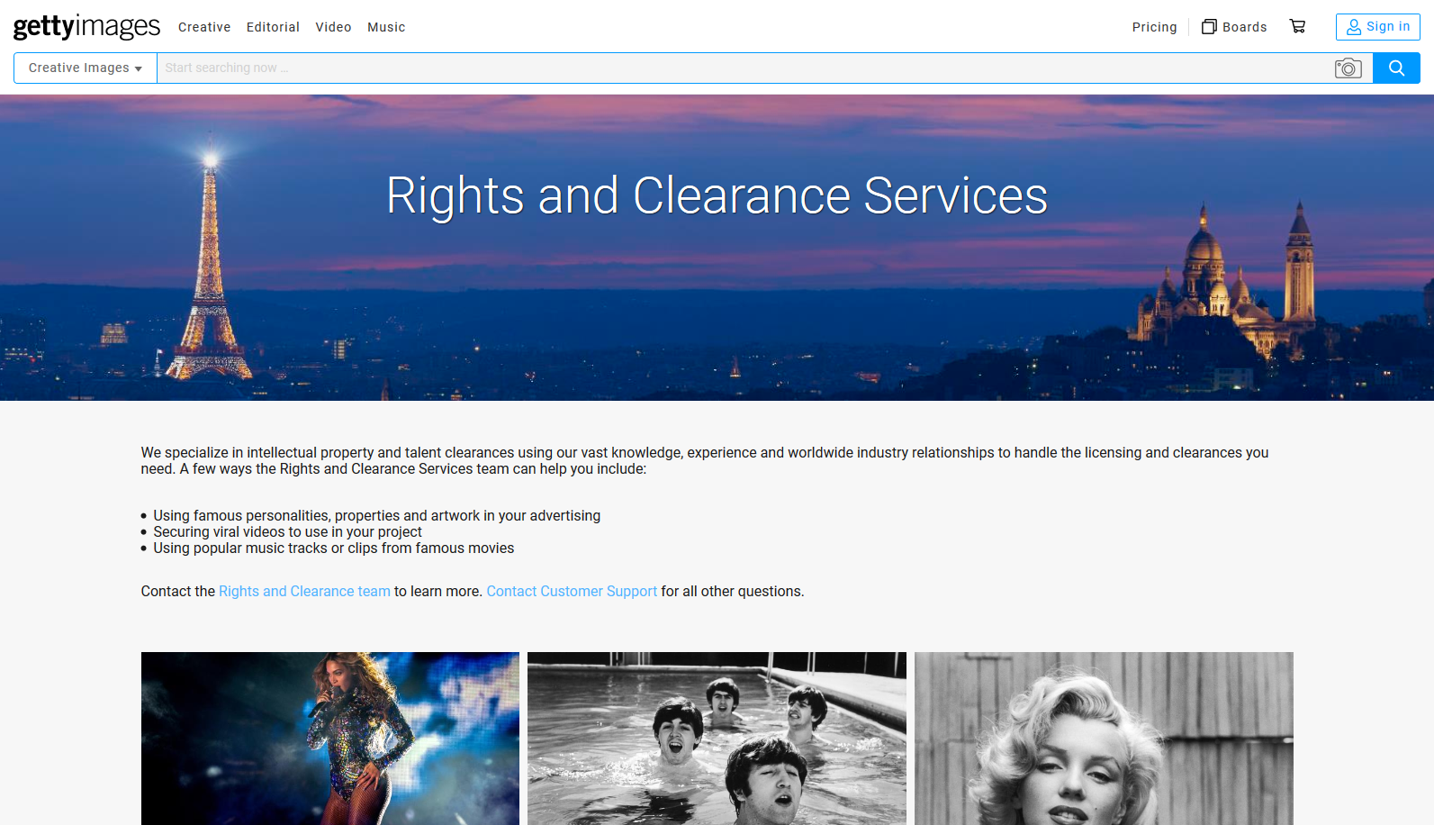
Yes, you need permission even if the subject is deceased…

Slide 14
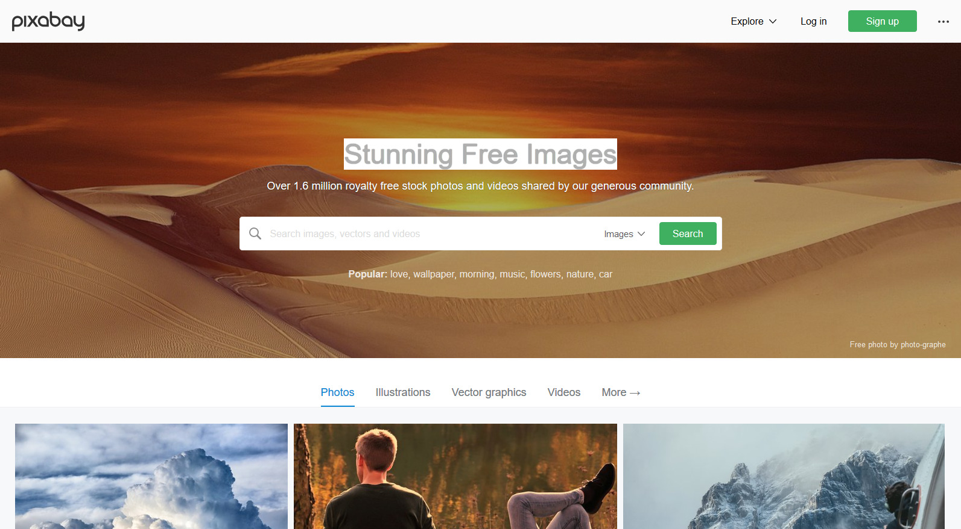
Free images and videos you can use anywhere
Pixabay is a vibrant community of creatives, sharing copyright free images and videos. All contents are released under Creative Commons CC0, which makes them safe to use without asking for permission or giving credit to the artist - even for commercial purposes.
Learn more...

Slide 16

Trademarks

Slide 17
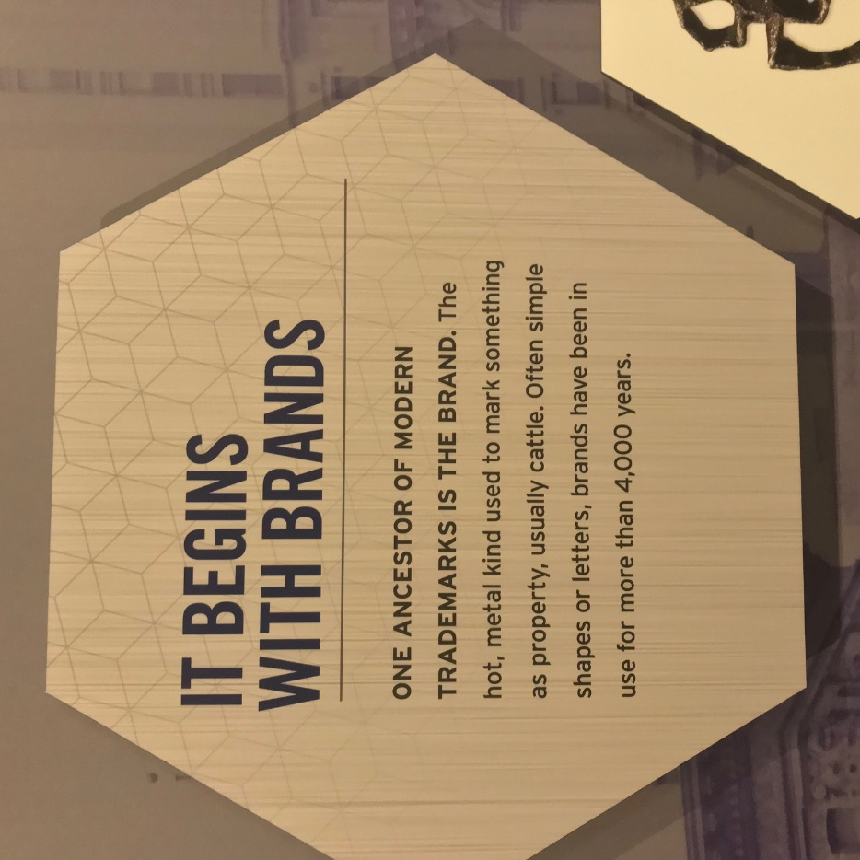
“word, phrase, symbol or design, or a combination of words, phrases, symbols or designs, that identifies and distinguishes the source of the goods/services of one party from those of others”

Slide 19
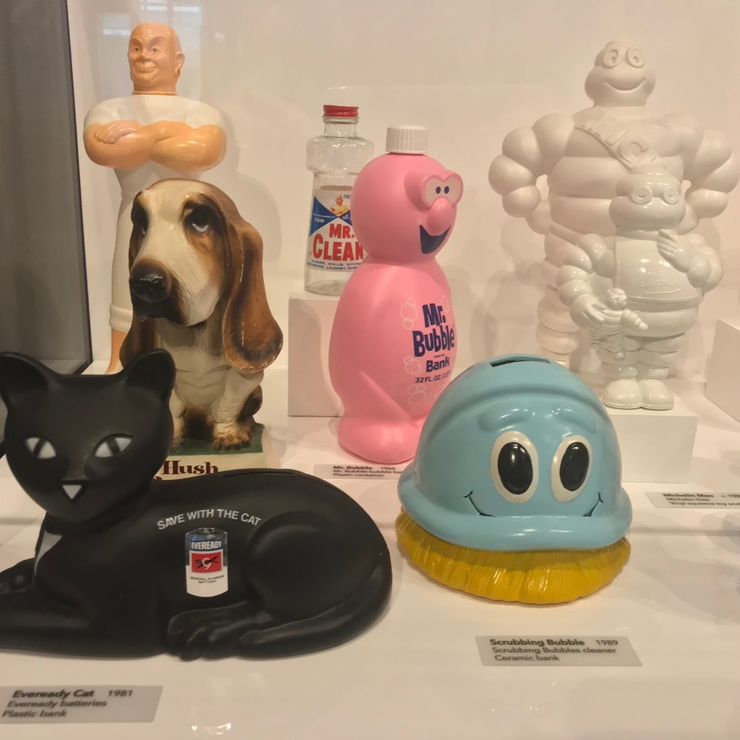
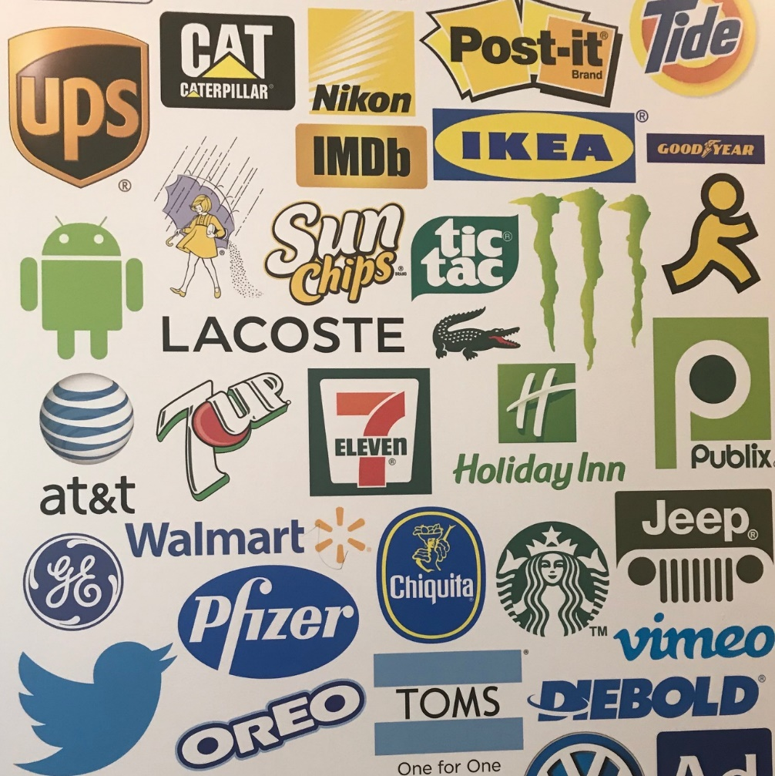

Slide 21

How an attorney can help…
Photo by rawpixel on Unsplash

Slide 22
Review a LICENSE AGREEMENT
Advise you whether you need a © or ®
Prepare Applications
Defend you if accused of infringement
Create a business entity for you
  Corporation
  Limited Liability Company

Slide 23
How to find a lawyer/one I can afford?
Intellectual Property Attorney
Business Law Attorney
Word of mouth
Lawyers for the Creative Arts (in Chicago)
https://law-arts.org/
161 North Clark Street, Suite 4300
Chicago Bar Association lawyer referral
service

Slide 24


About Legal Self-Help Sites:

Slide 25

Pixabay -
Free for commercial use
No attribution required
Copy and share this PowerPoint abundantly!

