Slide 1
Copyright Basics for Photographers
November 29, 2018 – Deerfield Public Library
Thank you, Chicago Photographic Arts Society, for hosting me today
Law Office of Lesley A. Wallerstein, LLC 500 Lake Cook Road, Suite 350 Deerfield IL 60015 (847) 912-3553 law@wallerstein-ip.com

Slide 2
Copyrights

Slide 3
What is a Copyright?
Federal statute gives “authors” the exclusive right to:
Perform
Display
Distribute
Reproduce
Create “derivative works of”
Their work

Slide 4
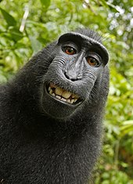
Who can own a copyright?
Naruto the macaque took this selfie but he is not a “person” therefore can’t copyright it

Slide 5
What does a copyright protect?
Paintings, sculpture, photographs
Books
Music
Drama
Movies
Software – an alternative to a patent?

Slide 6
Why register a copyright?
Inexpensive - $35/$55
Long term – Author’s life + 70 years
Right to sue in federal court
Statutory damages
$750 - $30,000 per work, up to $150,000 if willful
Attorneys’ fees

Slide 7
How to register a copyright
U.S. Copyright Office – www.copyright.gov
Type of work
Who is the author/claimant
Work for hire
Single/group registration
Deposit – online or mail

Slide 8
About the registration process:
“Examined” for originality/lack of utility
Process is difficult to track / opaque
9+ months to receive certificate
Appeal rejections - $200+

Slide 9
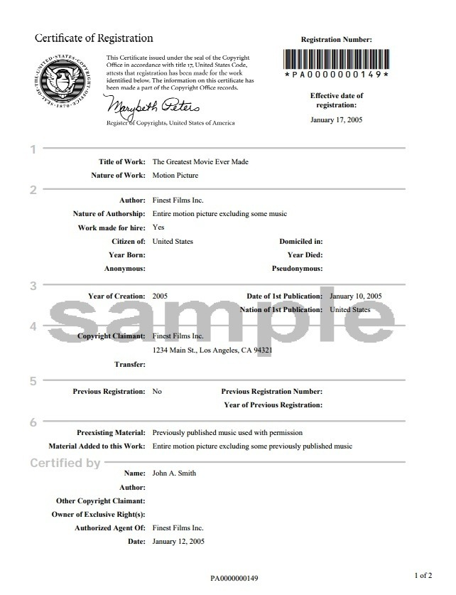

Slide 10
Copyright Infringement
What is infringement and what is not?
Copying without permission
Intent not needed
“Fair Use” defense – depends on purpose and effect of copying
Social commentary / First Amendment
Educational
Minimal borrowing
Financial impact on copyright owner

Slide 11
When do you need permission to use a photo?
When you do not?
Rule of thumb: if you did not take the photo, you need permission.
Exceptions:
Public Domain – works created before 1923
Creative Commons license
Other, written, permission

Slide 12
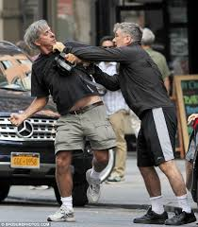
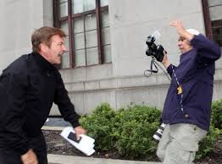
When do you need permission to *take* a photo of someone?
Can you identify the person in the photo?
Expectation of privacy: public / private space
Celebrities and public figures
When in doubt, ask permission (written is best!)

Slide 13
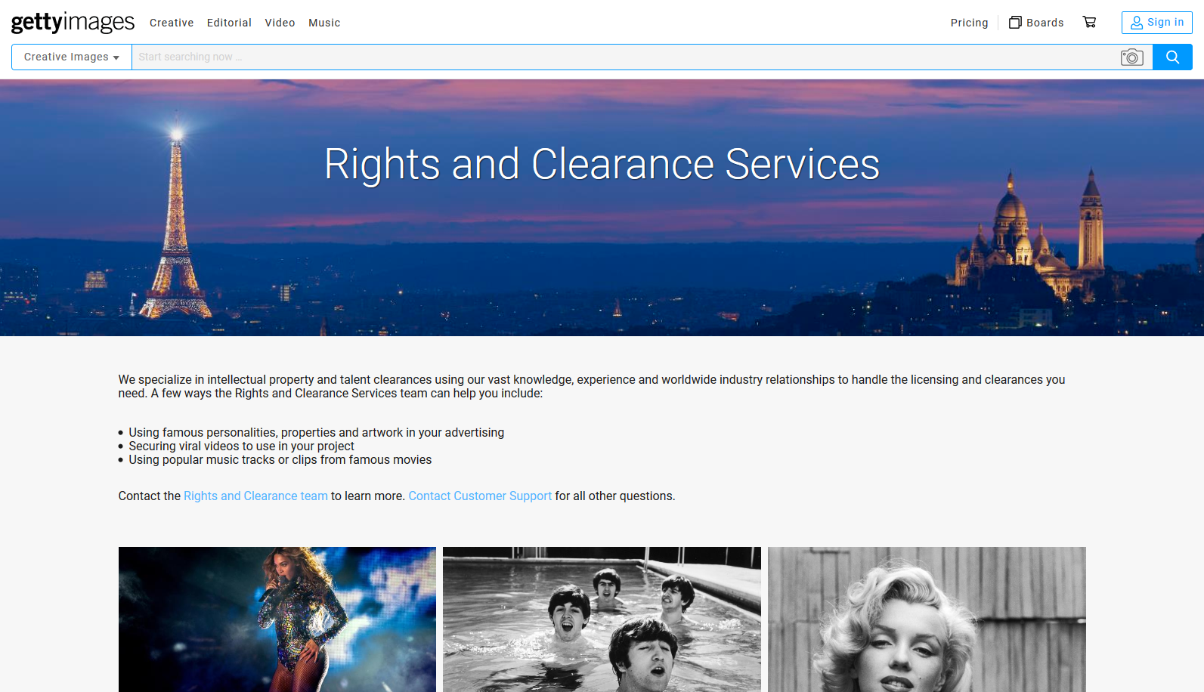
Yes, you need permission even if the subject is deceased…

Slide 14
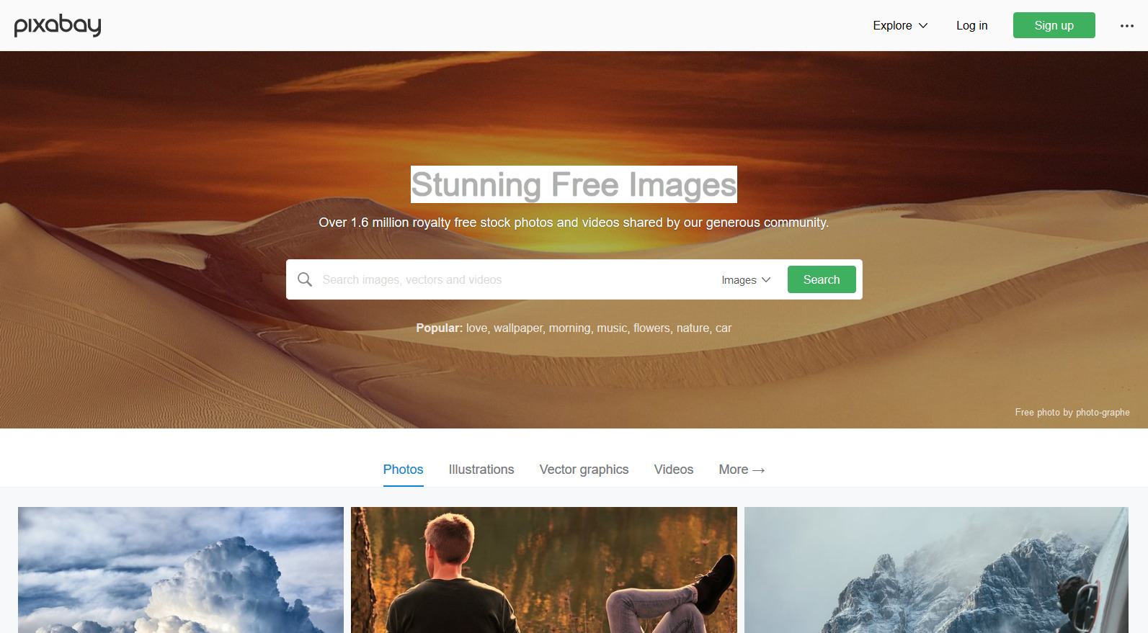
Free images and videos you can use anywhere
Pixabay is a vibrant community of creatives, sharing copyright free images and videos. All contents are released under Creative Commons CC0, which makes them safe to use without asking for permission or giving credit to the artist - even for commercial purposes.
Learn more...

Slide 15
How an attorney can help…
Intellectual Property Attorney
Business Law Attorney
Lawyers for the Creative Arts
Photo by rawpixel on Unsplash

Slide 16
Legal Self-Help Sites

Slide 17
Pixabay -
Free for commercial use
No attribution required
Copy and share this PowerPoint abundantly!

